Slide 1
Online Food Delivery
Group - 6
Neha Dattatray Patel 2479425
Pavithra Poojary 2480135
Burra Venkata Sunil Babu 2482081
Hemnath Krishnamoorthy 2483095
Kushal GowdA. H 2481270
Pothuru Venkata Likhith Suraj 2482968
Ragini. H 2480168
Rajasekar Kothandan 2481779
Rapolu Bhagyalakshmi 2482712
Sandhiya. P 2481737

Slide 2
Contents
Abstract
Objectives
System Requirements
App flow
Features Available
Future Scope
Conclusion

Slide 3
Abstract
ONLINE FOOD DELIVERY SYSTEM is a website designed primarily for use in the food delivery industry.
This system will allow hotels and restaurants to increase scope of business by reducing the labor cost involved.
The system also allows to quickly and easily manage an online menu which customers can browse and use to place orders with just few clicks.
Restaurant employees then use these orders through an easy to navigate graphical interface for efficient processing.

Slide 4
Objective
The main objective of the Project on Online Food Ordering System is to manage the details of Food Item, Category, Customer, Order, Confirm Order.
It manages all the information about Food Item, Payment, Confirm Order, Food Item.
The purpose of the project is to build an application program to reduce the manual work for managing the Food Item, Category, Payment, Customer.
It tracks all the details about the Customer, Order, Confirm Order

Slide 5
System Requirements
Hardware Requirement
Processor
RAM
Had Disk
Software Requirement
Inter hardware Machine
Server
Eclipse IDE or Spring tool Suite
VS Code
Back-end –MY SQL, hibernate

Slide 6
Features Available
Admin
Login
Create Admin Account
Add or Remove Different Cuisines
Edit Food Item
ENDUSER
Register
Change Password
Update Profile
Sign into the application
Add all the selected item
Seamless payment process

Slide 7
App Flow
Availability
User-Id
F_Name
Description
Curations
Phone_no
L_Name
Menu_Id
Dish_name
City
Has
Have
email_id
Sign-up
Menu
State
Delivery Fee
Admin-login
email
Has
Dish_Price
Have
URL
Password
User_Id
Payment_Id
Menu_Id
Has
Payment Mode
Orders
Payment
Order_Id
Address
Date
Quantity
Payment_Id

Slide 8
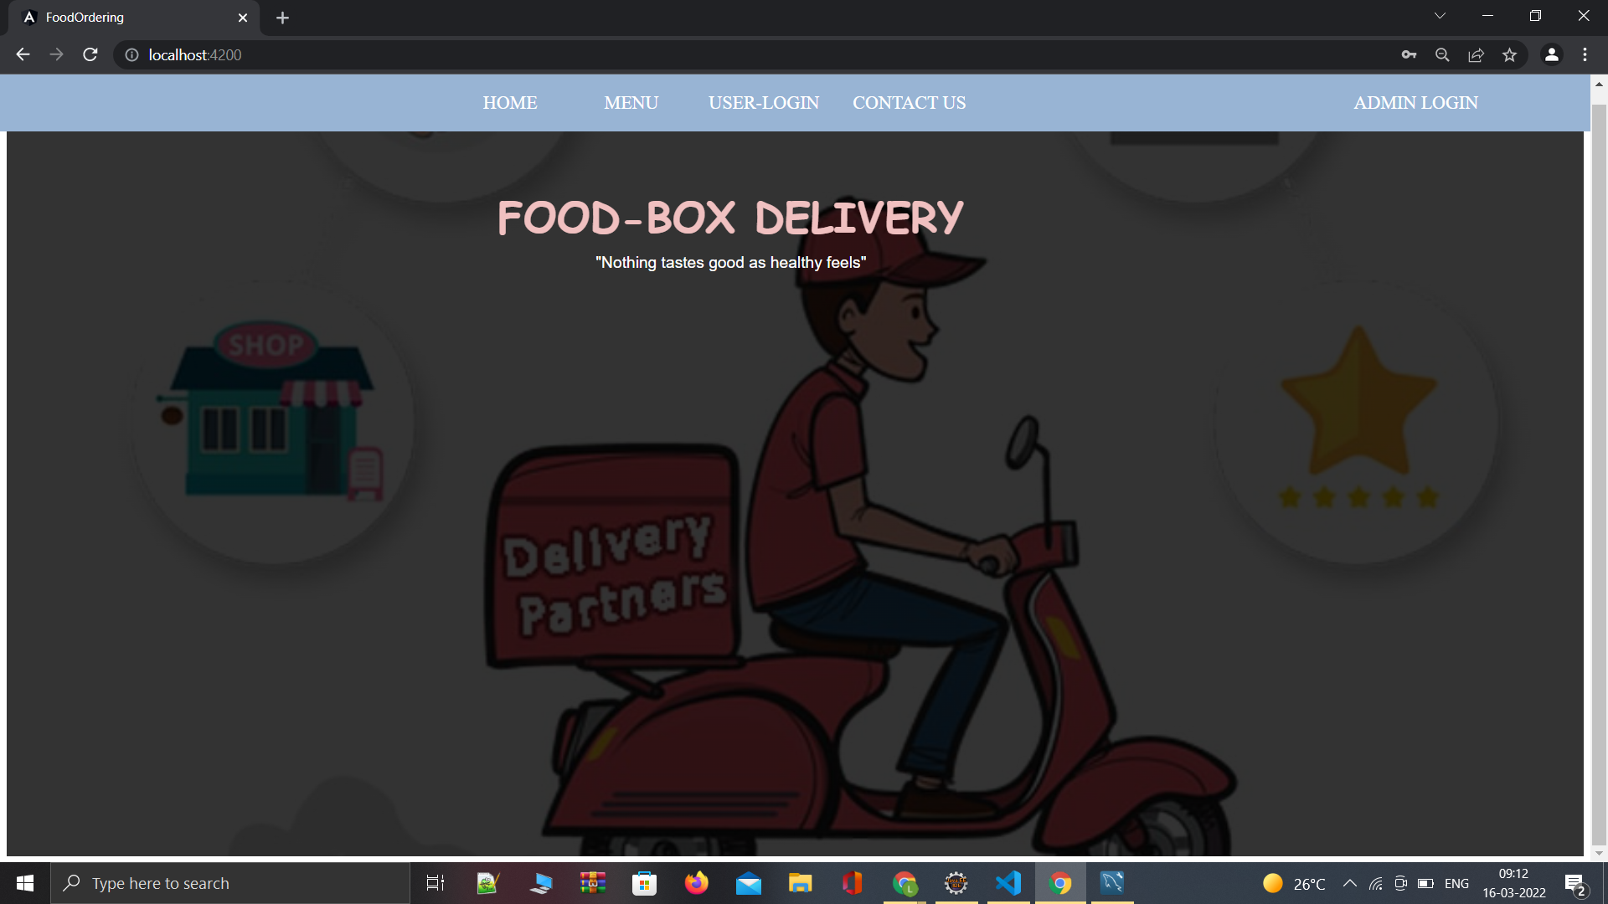
Home Page

Slide 9
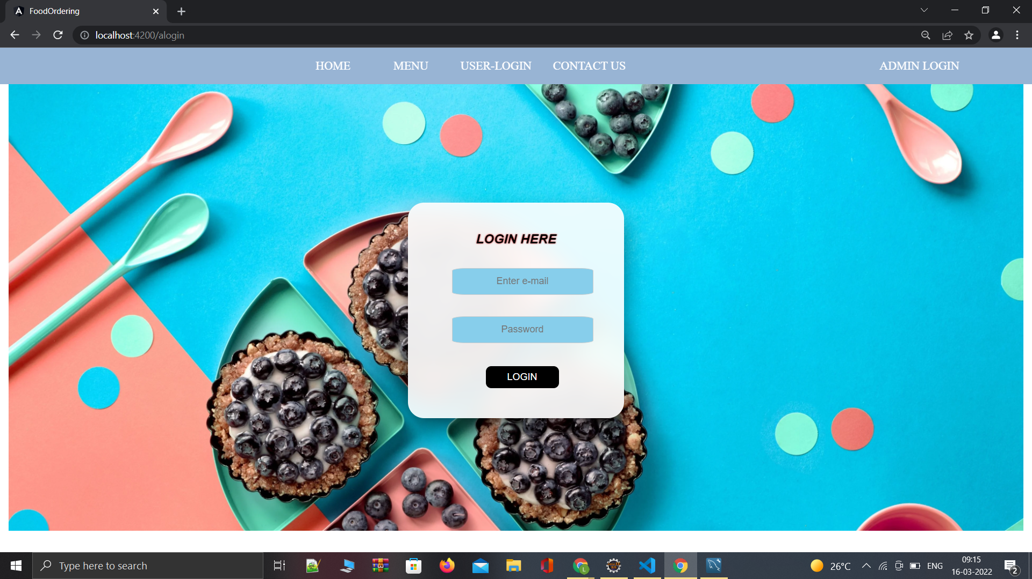
Admin Login Page

Slide 10
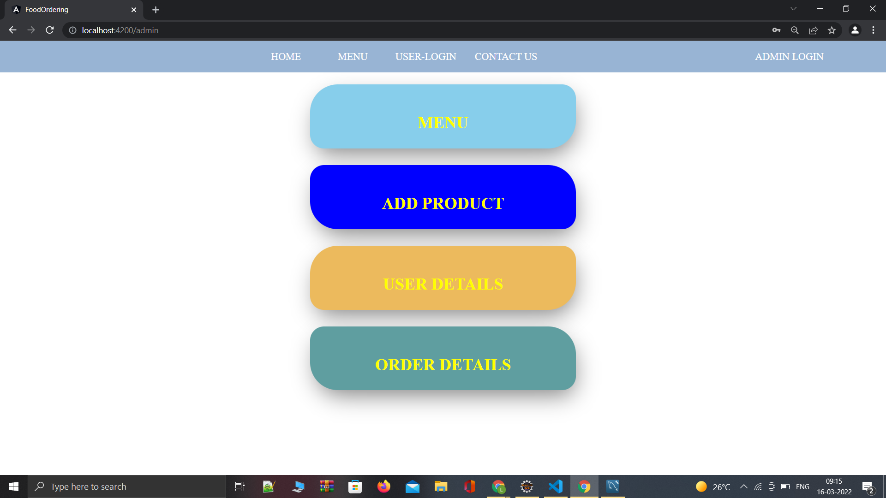
Amin Page

Slide 11
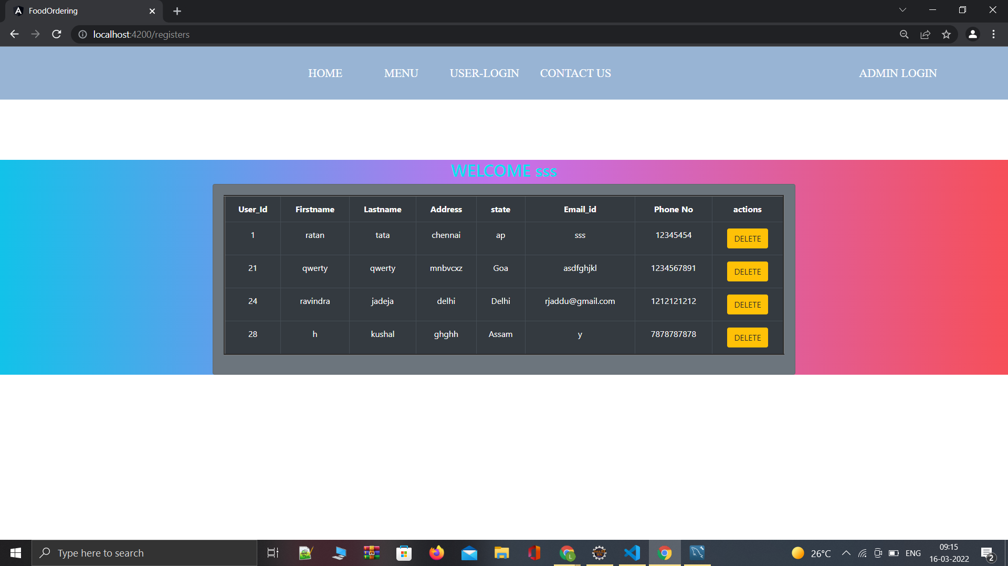
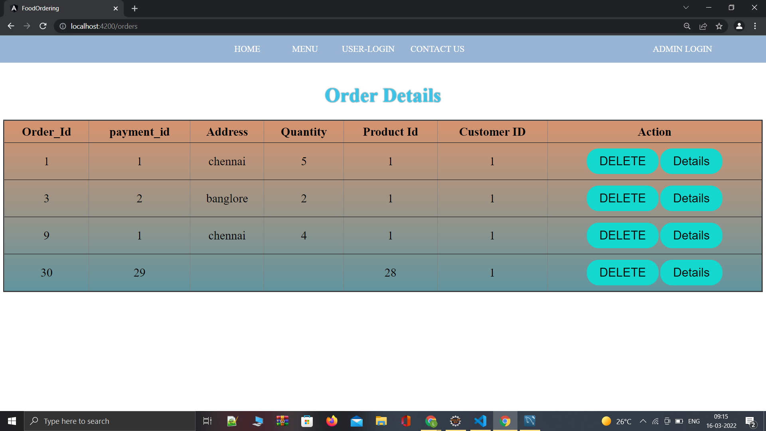
User Details and Order Details

Slide 12
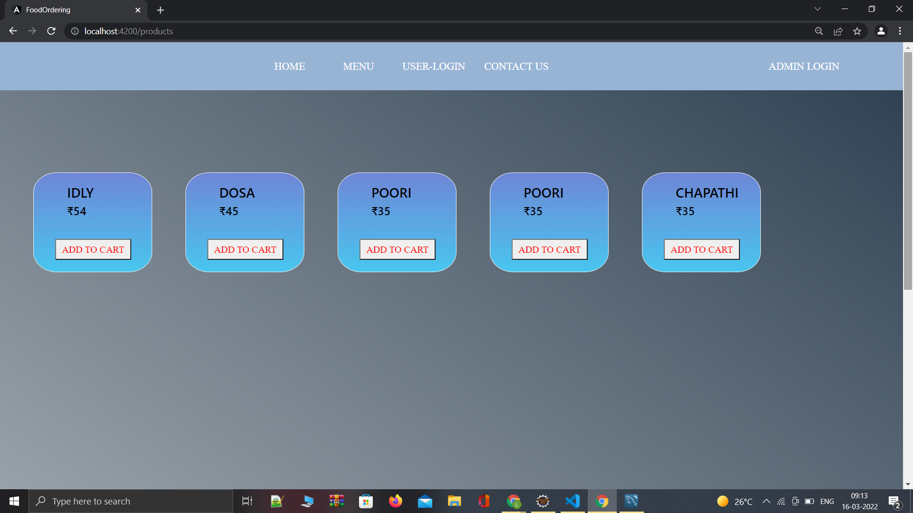
Menu Page

Slide 13
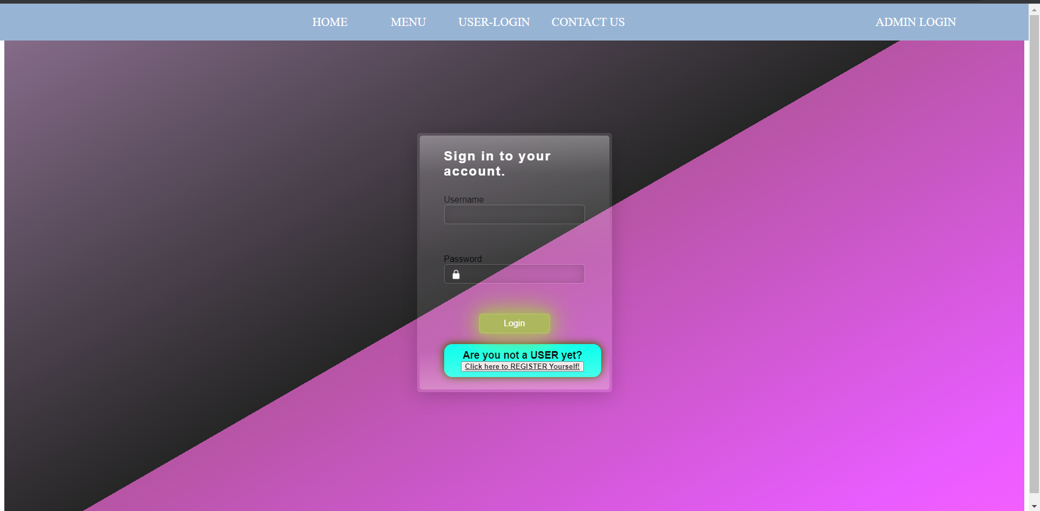
User Login Page

Slide 14
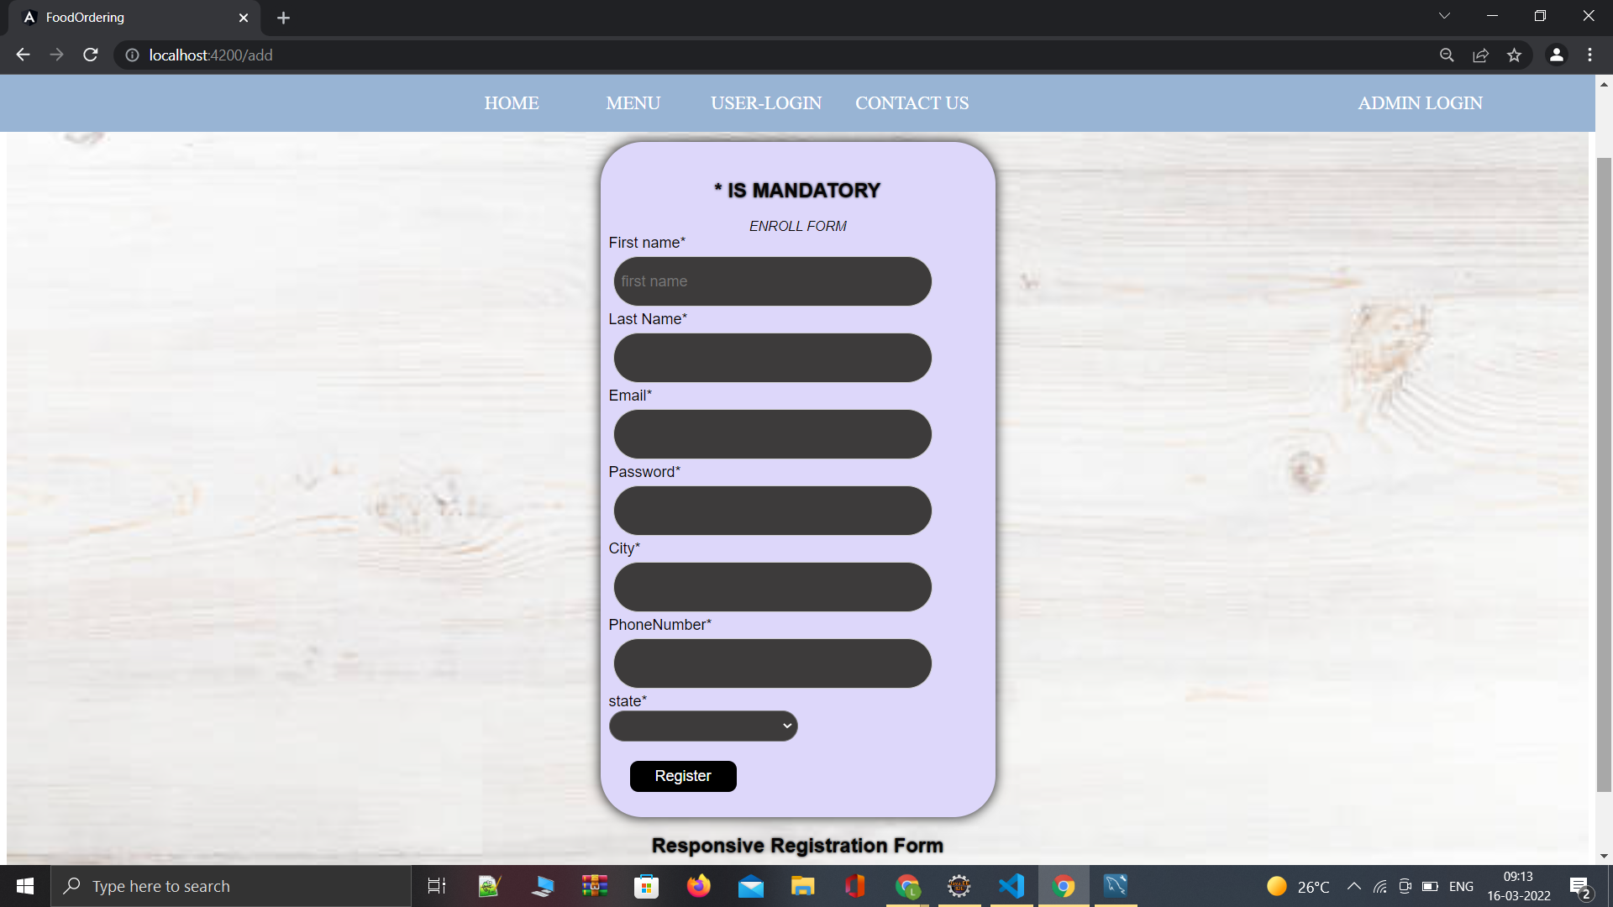
User Registration Page

Slide 15
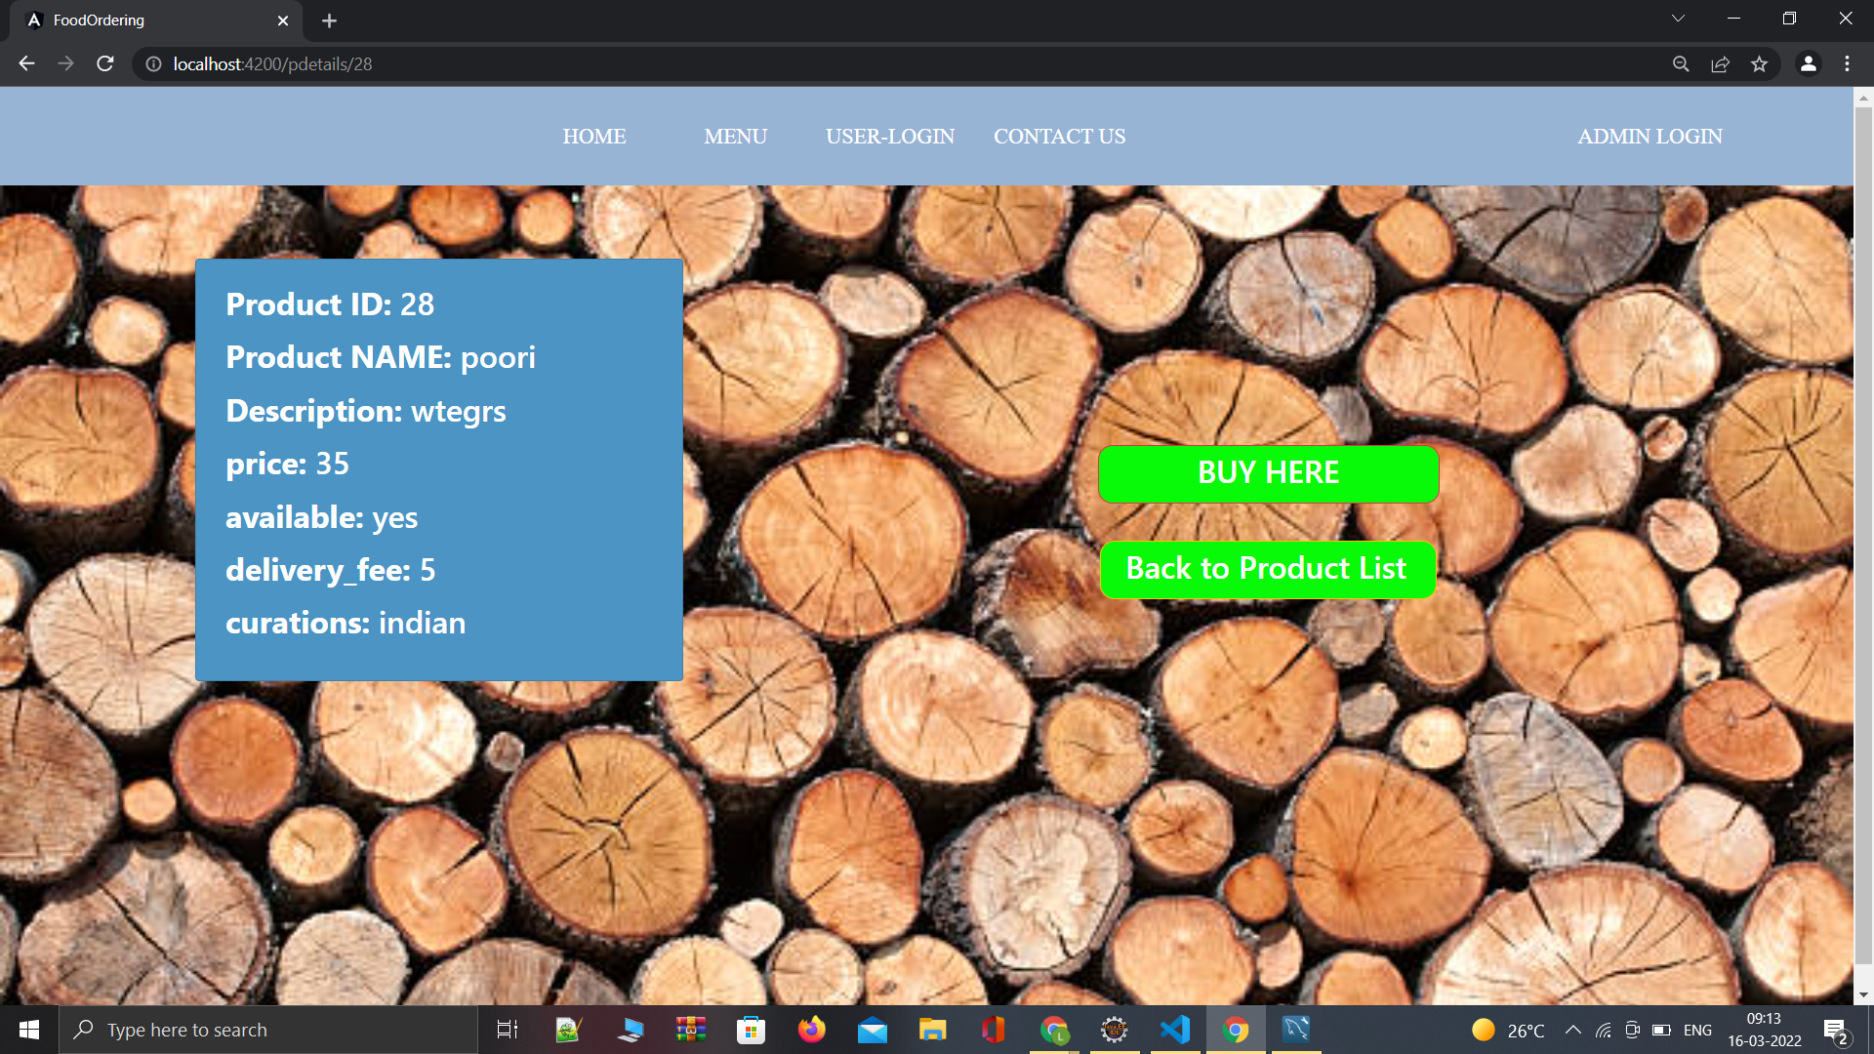
Product Details

Slide 16
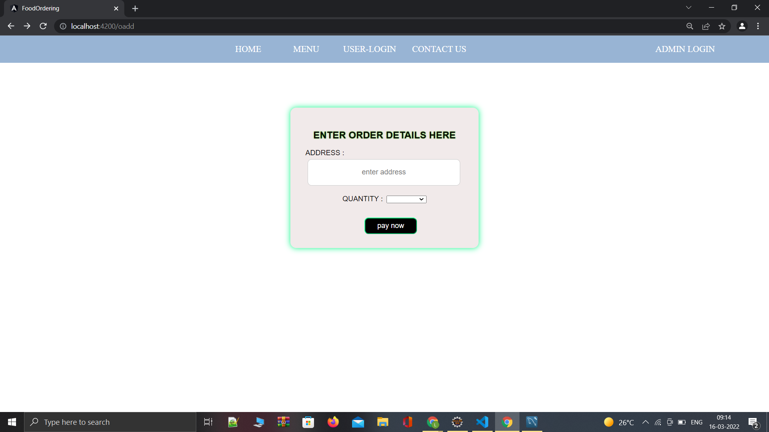
Placing Order

Slide 17
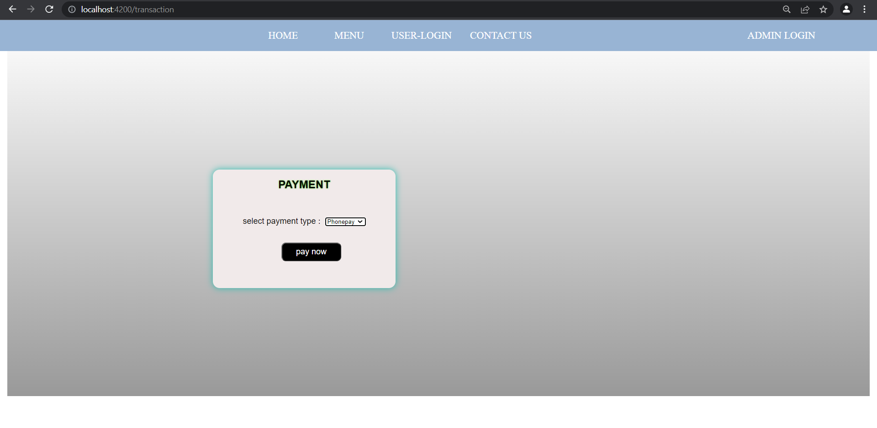
Adding Payment Method

Slide 18
Future Scope
We will host the platform on online servers to make it accessible worldwide.
We can give more advanced software for online food delivery system including more facilities
Send Order ready notification to the user

Slide 19
Conclusion
In conclusion an online food ordering system is proposed which is useful for small to large restaurants.
With a website or mobile app, customers can easily browse all the dishes the restaurant has available, customize dishes to their requirements and place an order.
This project can later be expanded on a larger scale.

Slide 20
App Flow
Availability
Dish_name
User-Id
F_Name
Description
Curations
Phone_no
L_Name
Menu_Id
Dish_Price
City
Have
Sign-up
Menu
Delivery Fee
Has
Has
State
email_id
URL
Has
email
Admin-login
Password
Have
Has
User_Id
Payment_Id
Menu_Id
Has
Payment Method
Orders
Payment
Order_Id
Address
Date
Quantity
Payment_Id

